Slide 1

BIDEN CRYPTO Final Project

Slide 2
Table of contents
01
02
03
04
About the project
Front-End
Back-End
Our Team

Slide 3
About the project
01

Slide 4


Introduction

Slide 5



What are we working on?

Slide 6
About the project
The Biden-Crypto is a place to exchange information, capitalization, and prices of the cryptocurrency market. It's is a decentralized cryptocurrency exchange platform that allows users to trade cryptocurrencies with each other. Biden-crypto is the easiest place to buy and sell cryptocurrency. Let's start your journey.
Our logo

Slide 7

—Steven Truong–
“GET RICH TOGETHER.”

Slide 8
Front-End
02

Slide 9
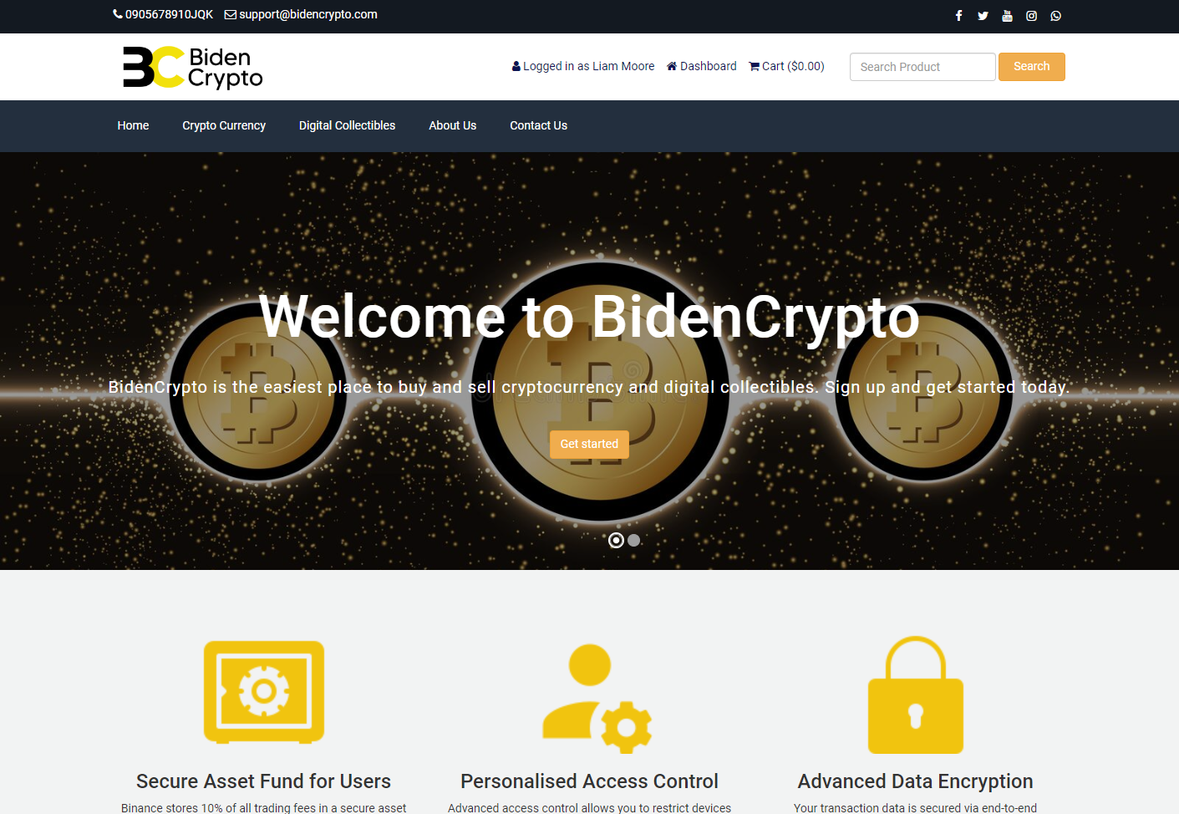
Home page

Slide 10

Category page

Slide 11
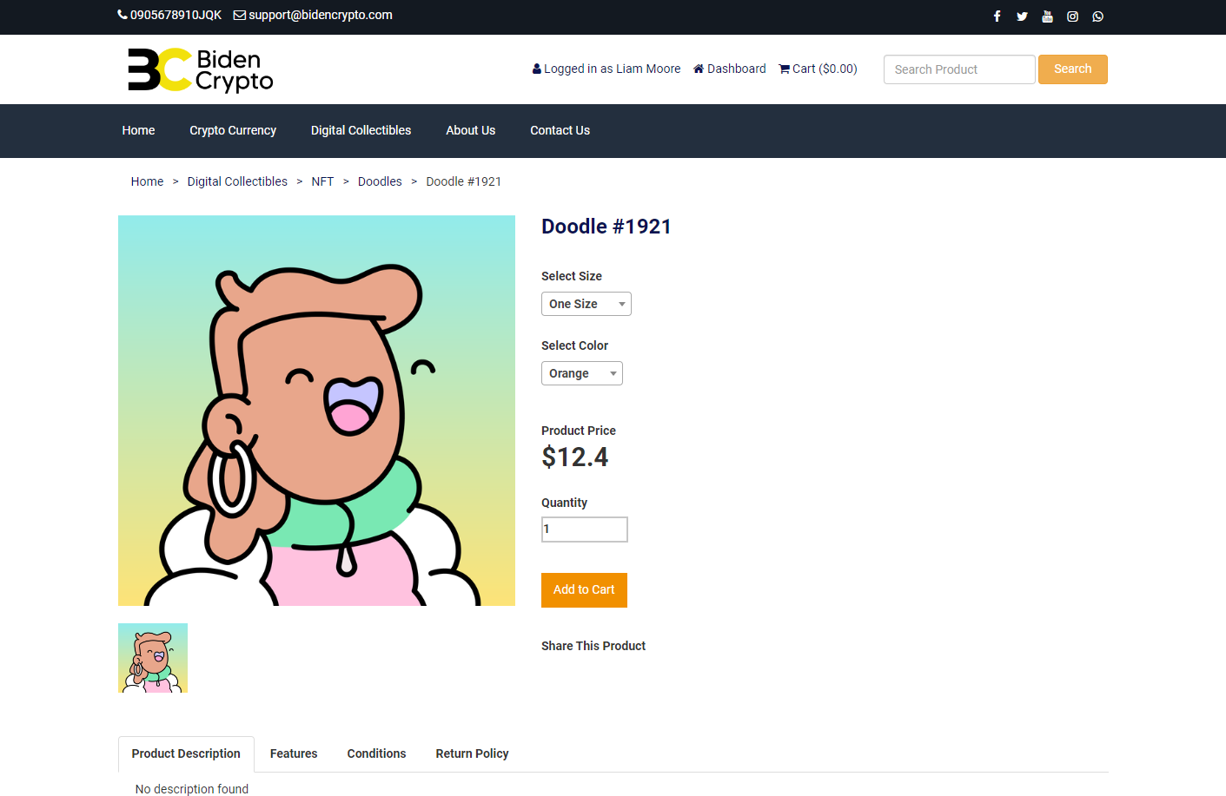
Product page

Slide 12
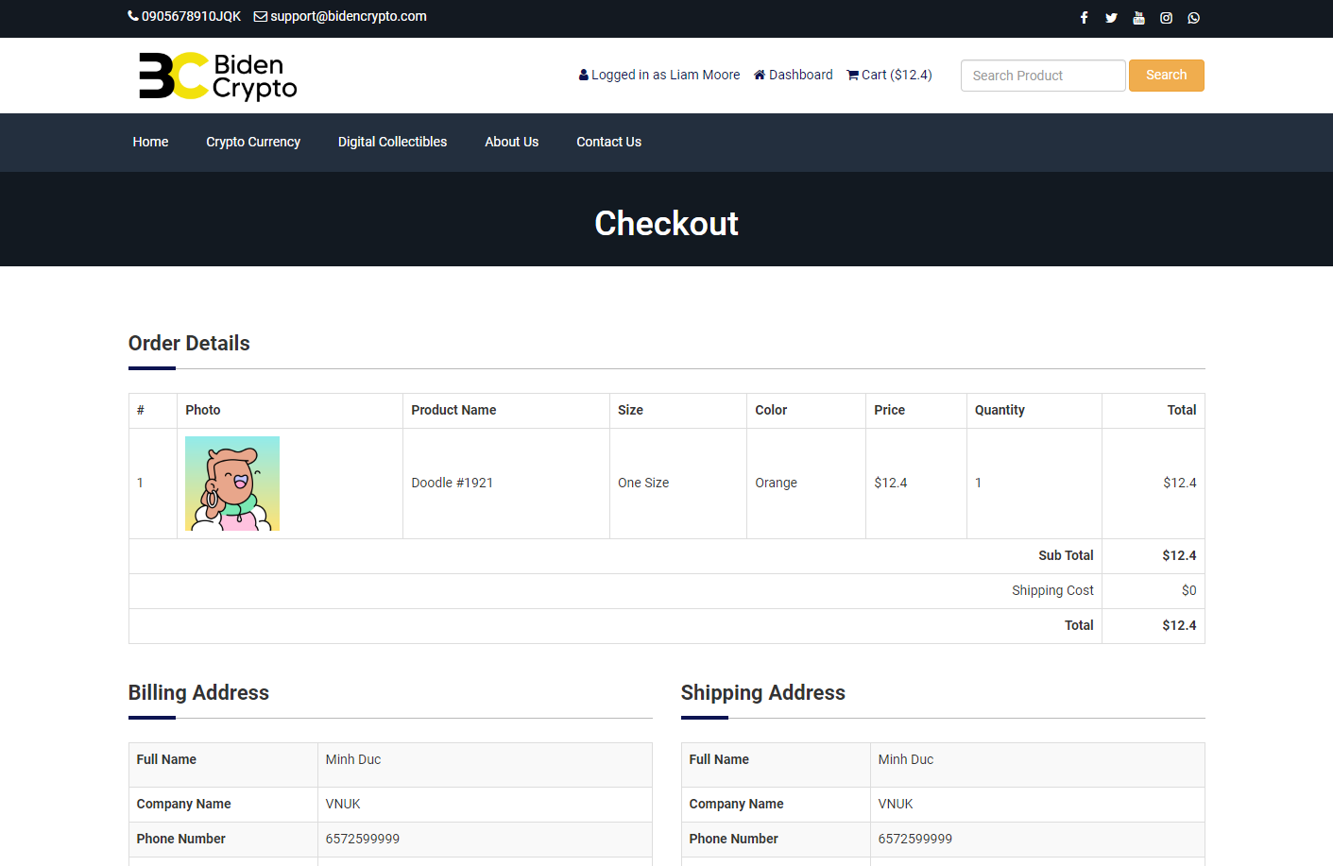
Checkout page

Slide 13
Back-End
03

Slide 14
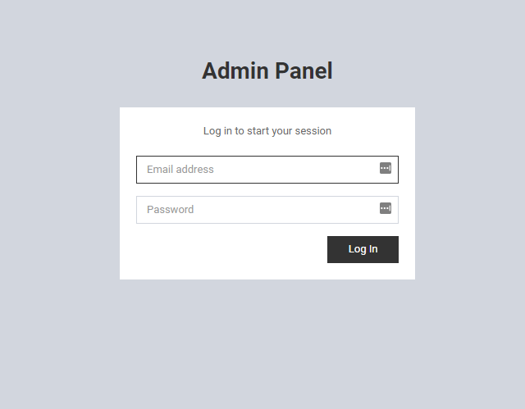
Login for administrator

Slide 15
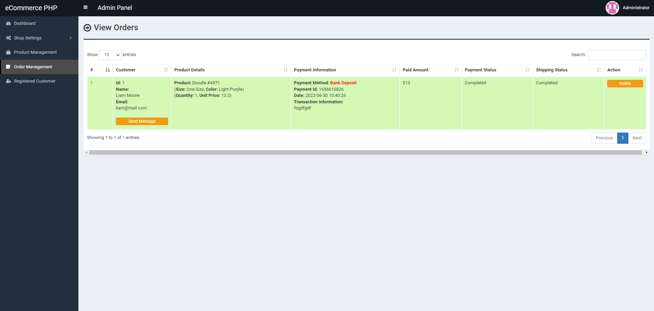
Order for admin

Slide 16
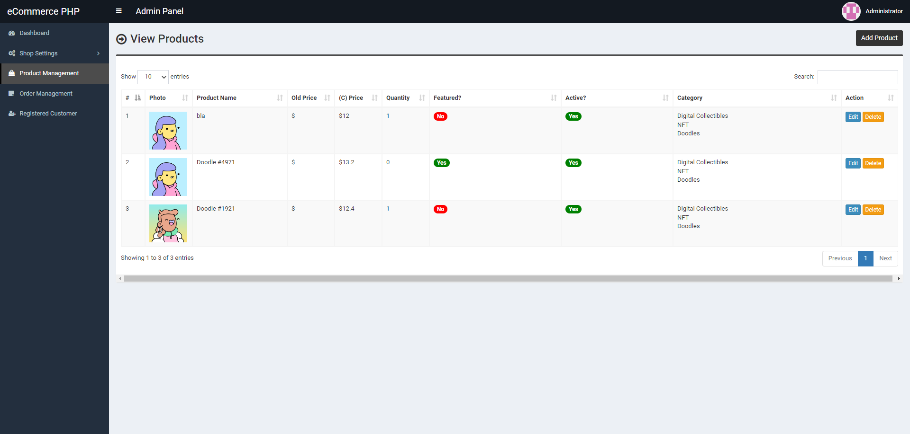
Product Listing + Product Management

Slide 17





Our team
Tri Hieu
Alex Nguyen
Steven Truong
Cong Thanh
BACK-END DEV
FRONT-END DEV
CEO
TESTER

Slide 18
Thanks!

